Slide 1
Microscope
Figure 1A
Figure 1B
a.
b.

Slide 2
 |  | GC Content
siRNA | Sequence (Sense strand 5' -> 3') | G | C | % GC Content | Tm Check
siRNA 2 | AACATGGCCATCATCAAGGAG | 5 | 5 | 47.6 | √
siRNA 3 | AAGGAGTTCATGCGCTTCAAG | 6 | 4 | 47.6 | √
siRNA 17 | AATGCAGAAGAAGACCATGGG | 7 | 3 | 47.6 | √
siRNA 28 | AACGTCAACATCAAGTTGGAC | 4 | 5 | 42.9 | √
siRNA 29 | AACATCAAGTTGGACATCACC | 3 | 6 | 42.9 | √
MOF | Voigt Bulk modulus | Voigt Shear modulus | Compressibility | C11 |  | Young Modulus
 |  |  |  |  |  | X | Y | Z
 | (GPa) | (GPa) | (GPa) | (GPa) |  | (GPa) | (GPa) | (GPa)
NU-901 | 23.74 | 8.87 | 80.20 | 36.02 |  | 29.50 | 20.79 | 5.02
NU-1000 | 19.92 | 6.40 | 50.26 | 20.86 |  | 11.30 | 11.30 | 4.04

Slide 3
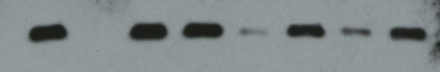
Blot
Western blot
(anti-RFP antibody)
Ponceau stain
Figure 1D
a.
b.
- 25kDa
Figure 1C
siRNA 2
siRNA 3
siRNA 17
siRNA 28
siRNA 29
No treatment -dox
No treatment +dox
Scrambled siRNA -dox
Scrambled siRNA +dox

Slide 4
Figure 2
Image below is copied as a source formatted file so easier to locate when changing

Slide 5
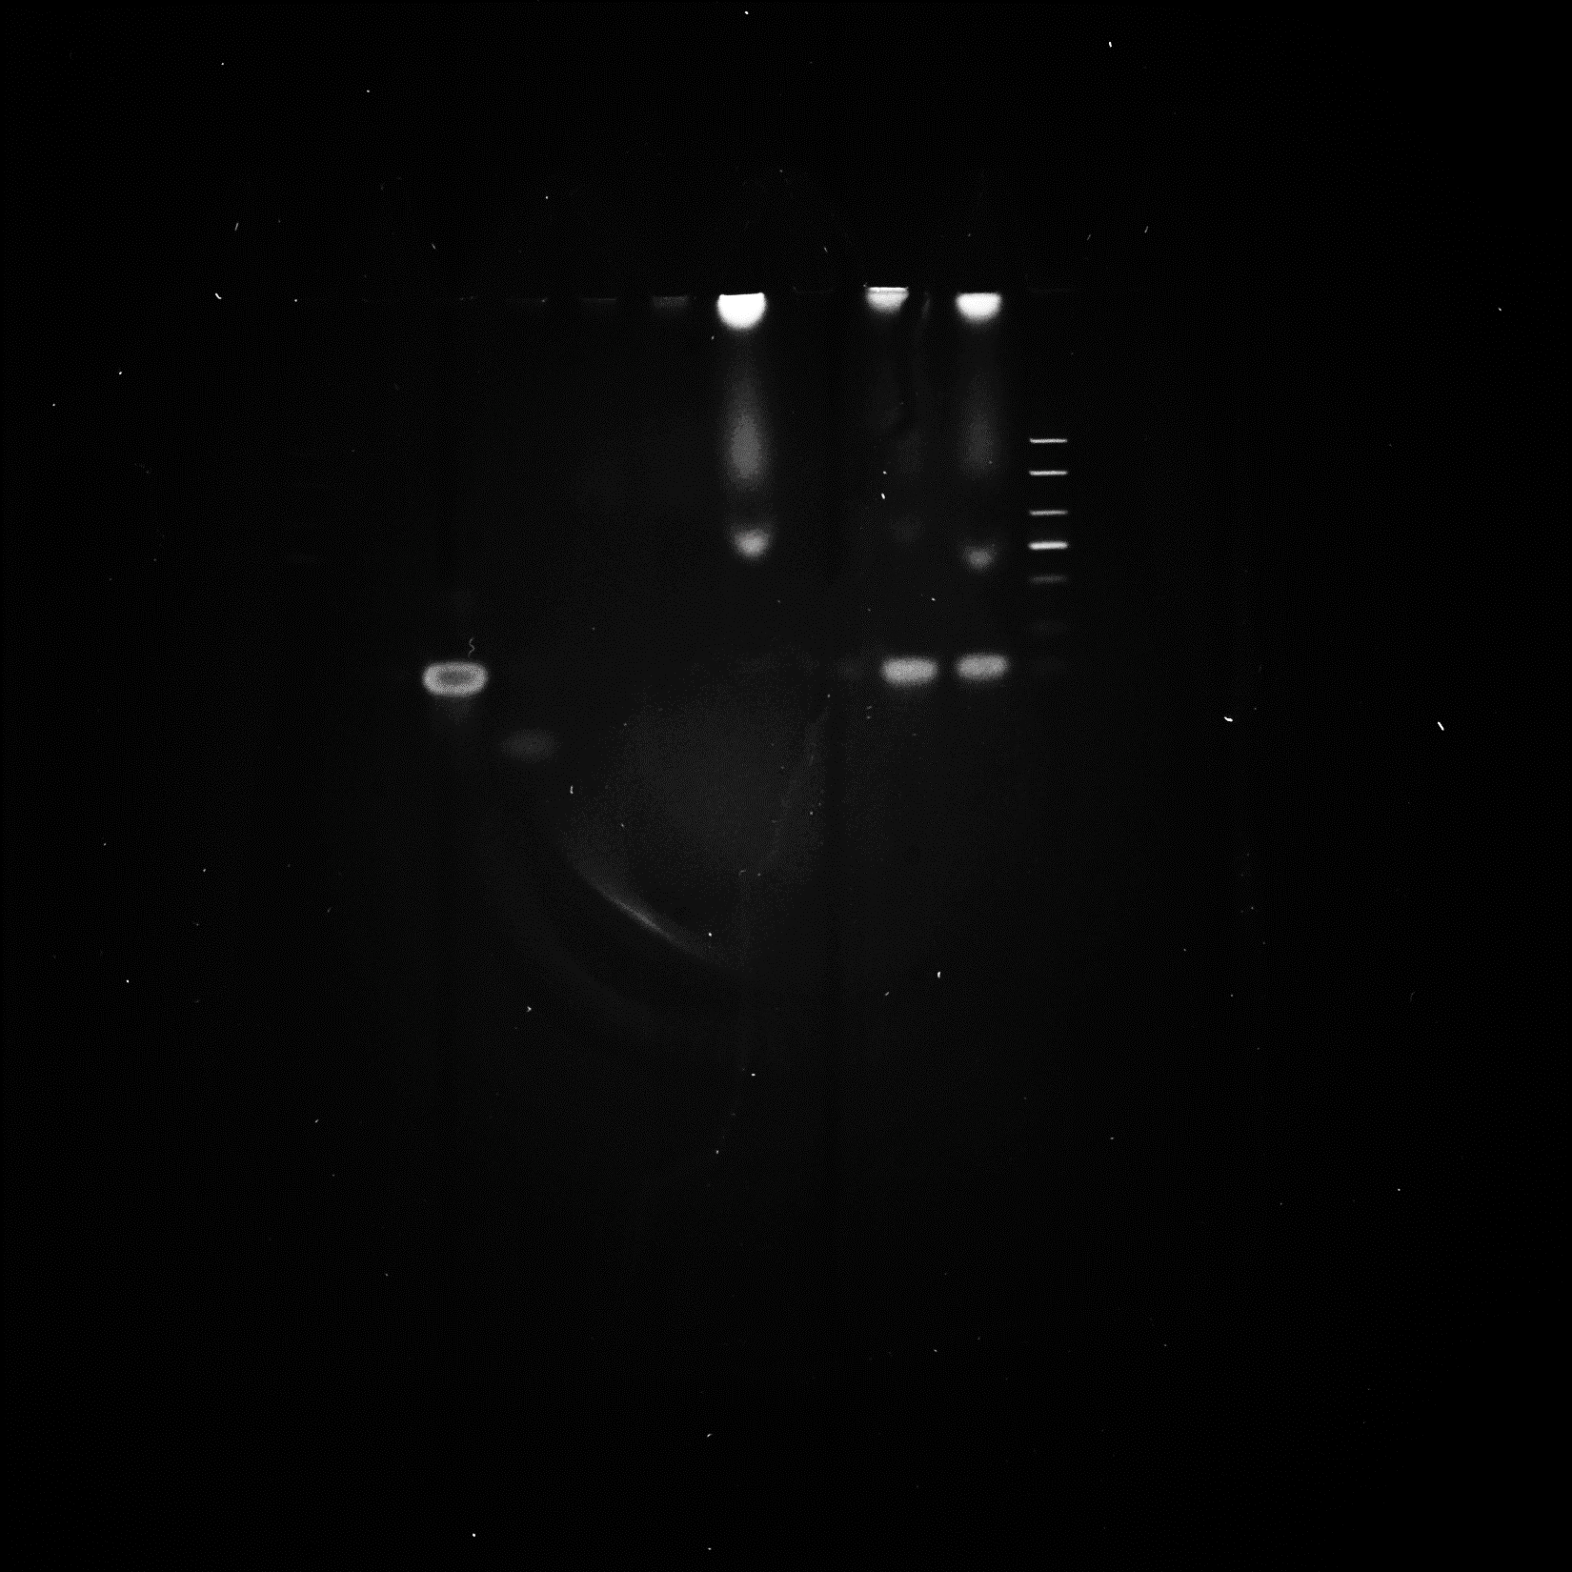
Figure 3A
siRNA@nNU-1000 w/enzyme
nNU-1000 only w/ enzyme
siRNA@nNU-1000 w/enzyme
Naked siRNA w/ enzyme
nNU-1000 only w/ enzyme
siRNA@nNU-1000
Naked siRNA w/ enzyme
Naked siRNA
dsRNA ladder
siRNA@nNU-1000
Naked siRNA
dsRNA ladder
Add legend here
- 80 nt
- 21 nt
- 21 nt

Slide 6
Overall figure
Figure 4A ->

Slide 8
Figure 4B
<- to check why this data doesn’t show 100% of positive control
Regardless, trends still apparent
Also, need to run significance tests on data with *** levels

Slide 10
Figure 5A

Slide 12
Supplemental figure?
TG FLIM data with tau value analysis

